Slide 1

Creation According to Genesis:
Literally or Literary?
Dr. Rick Griffith
Jordan Evangelical Theological Seminary
Available at the the Creation link at BibleStudyDownloads.org

Slide 2
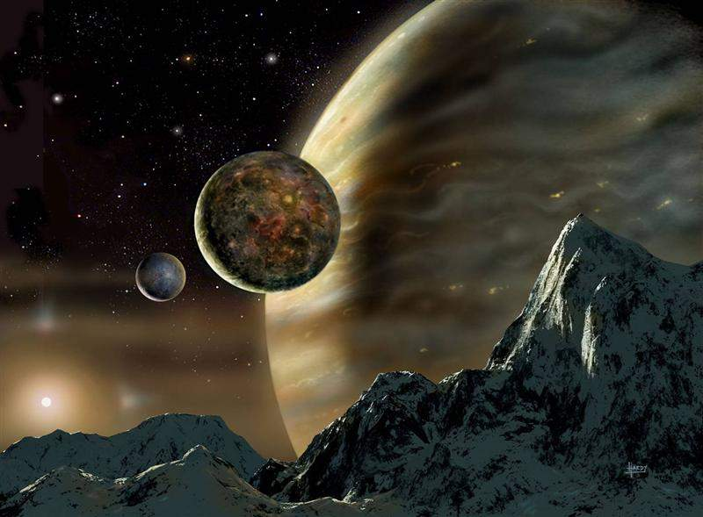
Creation in Six Days

Slide 3
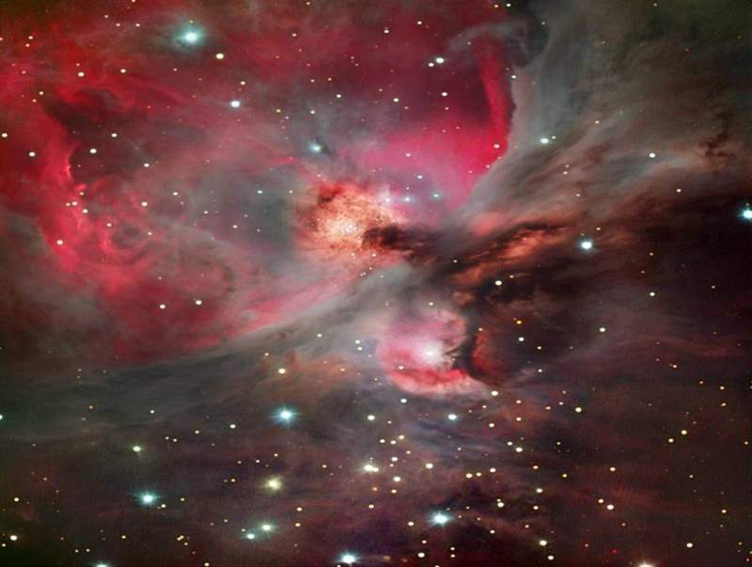
Day 1
God's Creation…Day 1
In the beginning God created
the heavens and the earth (1a).

Slide 4
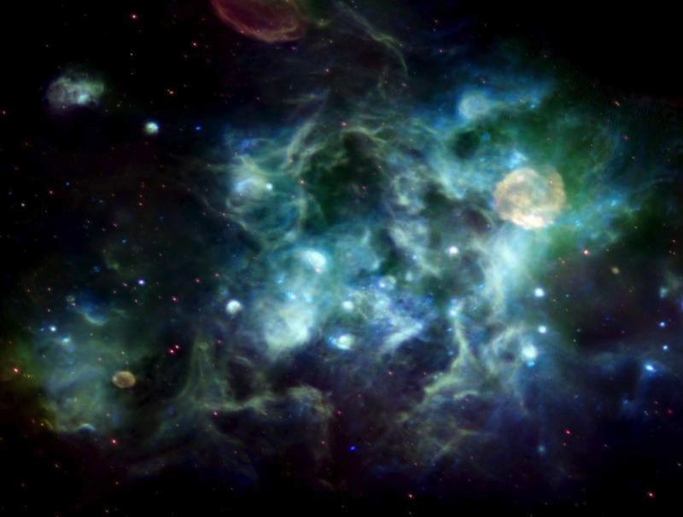
Formless & Void
God's Creation…Day 1
The earth was formless and void, and darkness was over the surface of the deep, and the Spirit of God was moving over the surface of the waters (2).

Slide 5
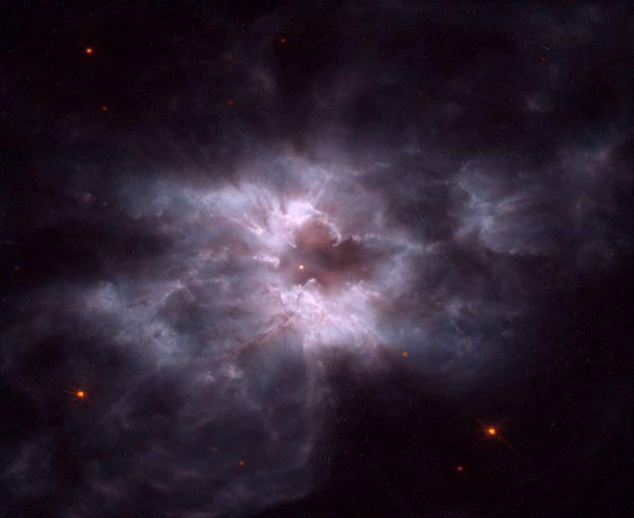
Light
God's Creation…Day 1
Then God said, "Let there be light"; and there was light. God saw that the light was good, and he separated the light from the darkness (3-4).

Slide 6
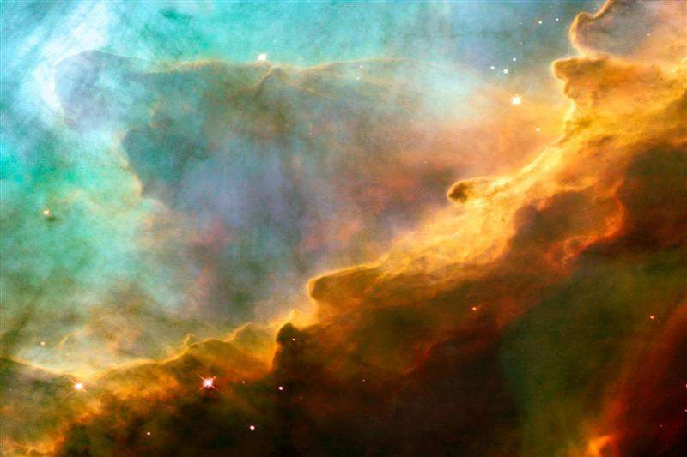
First Day
God's Creation…Day 1
God called the light day, and the darkness He called night. And there was evening and there was morning, one day (5).

Slide 7
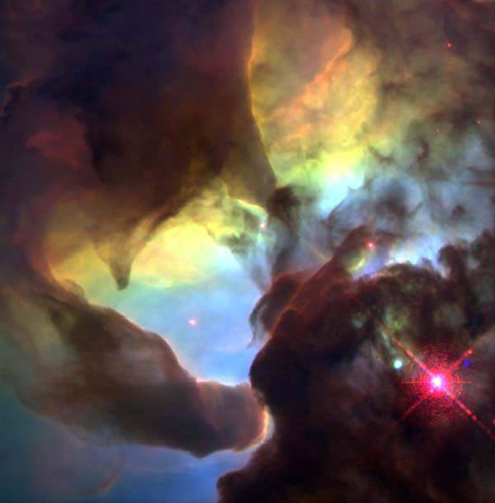
Day 2
God's Creation…Day 2
Then God said, "Let there be an expanse in the midst of the waters, and let it separate the waters from the waters" (6).

Slide 8
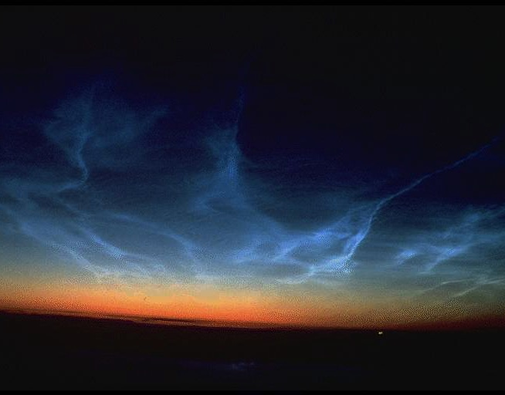
Expanse
God's Creation…Day 2
God made the expanse, and separated the waters which were below the expanse from the waters which were
above the expanse; and it was so (7).

Slide 9

Sky
God's Creation…Day 2
God called the expanse heaven (NIV "sky," 8a).

Slide 10
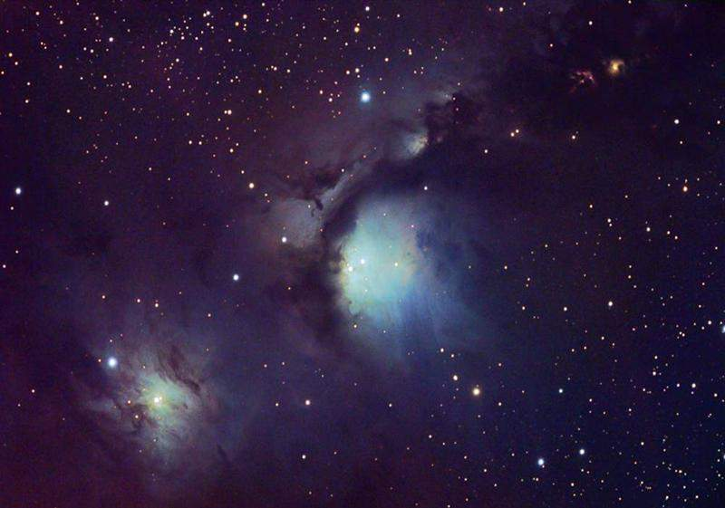
Second Day
God's Creation…Day 2
And there was evening and morning, a second day (8b).

Slide 11
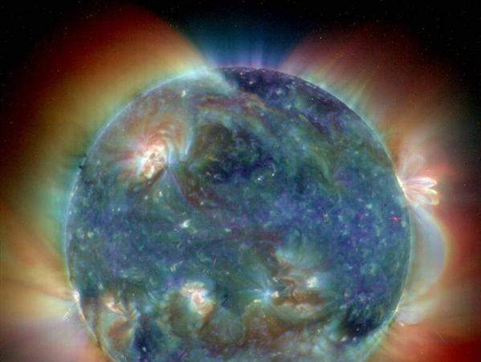
Day 3
God's Creation…Day 3
Then God said, "Let the waters below the heavens be gathered into one place, and let the dry land appear"; and it was so (9).

Slide 12

Rodinia––The World That Perished
The transformation of Adam's world into today's world

Slide 13
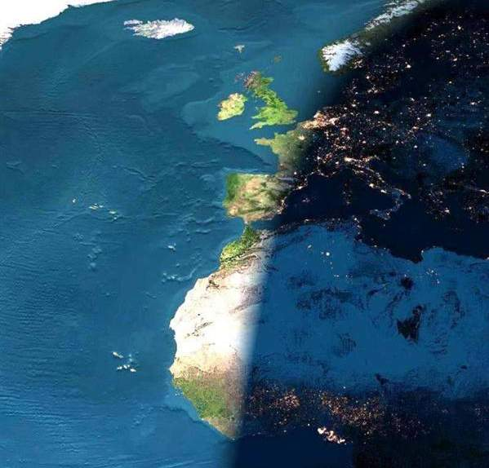
Land & Seas
God's Creation…Day 3
God called the dry land earth, and the gathering of the waters He called seas; and God saw that it was good (10).

Slide 14
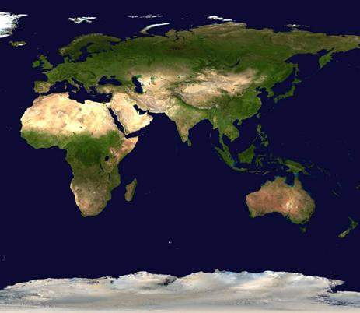
Vegetation
God's Creation…Day 3
Then God said, "Let the earth sprout vegetation: plants yielding seed, and fruit trees on the earth bearing fruit after their kind with seed in them," and it was so. The earth brought forth vegetation, plants yielding seed after their kind, and trees bearing fruit with seed in them, after their kind; and God saw that it was good (11-12).

Slide 15
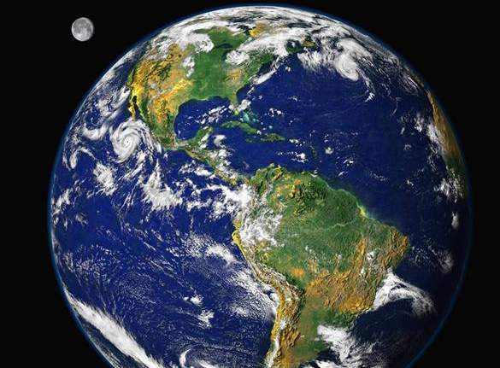
Third Day
God's Creation…Day 3
There was evening and there was morning, a third day (13).

Slide 16
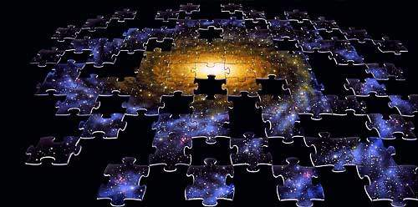
Day 4
God's Creation…Day 4
Then God said, "Let there be lights in the expanse of the heavens to separate the day from the night, and let them be for signs and for seasons and for days and years (14);

Slide 17
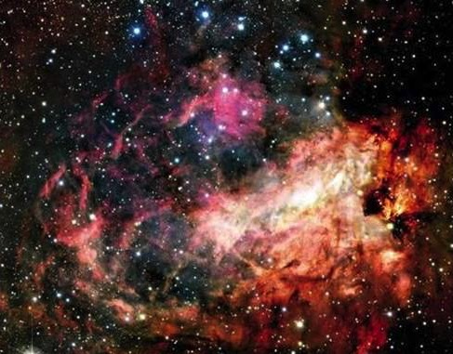
Sun & Moon
God's Creation…Day 4
And let them be for lights in the expanse of the heavens to give light on the earth"; and it was so (15).

Slide 18
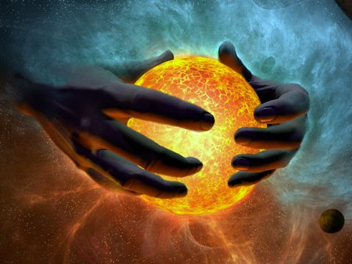
Sun
God's Creation…Day 4
God made the two great lights,
the greater light to govern the day (16a)…

Slide 19
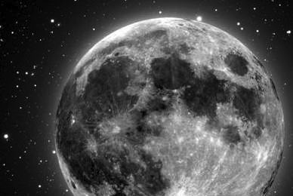
Moon
God's Creation…Day 4
…and the lesser light to govern the night (16b)…

Slide 20
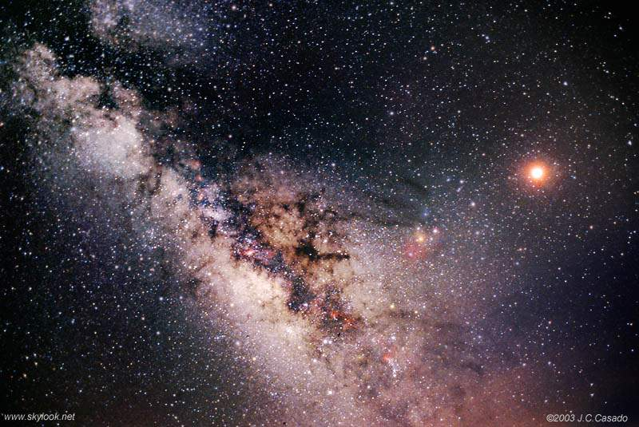
Stars
God's Creation…Day 4
He made the stars also (16c).

Slide 21
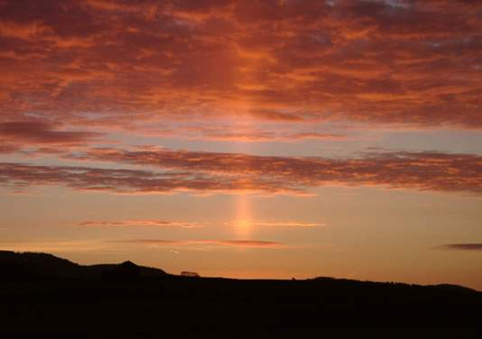
Fourth Day
God's Creation…Day 4
God placed them in the expanse of the heavens to give light on the earth, and to govern the day and the night, and to separate the light from the darkness; and God saw that it was good. There was evening and there was morning, a fourth day (17-19).

Slide 22
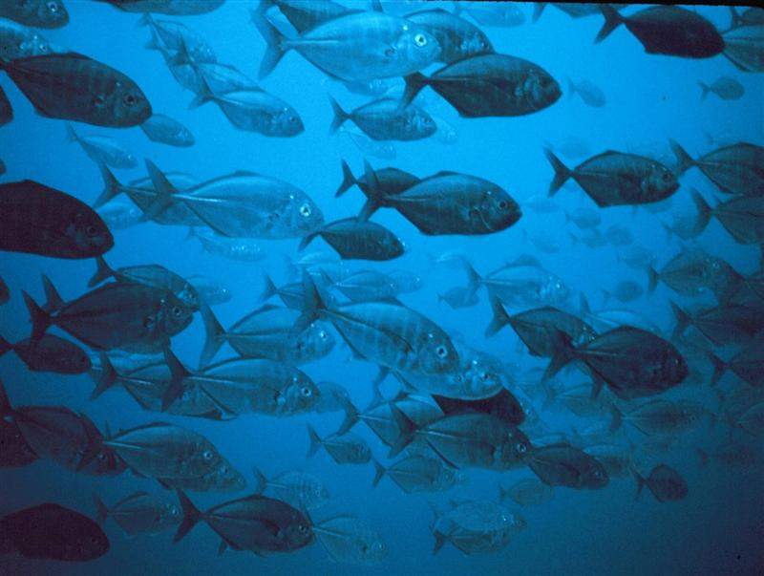
Day 5
God's Creation…Day 5
Then God said,
"Let the waters teem with swarms of living creatures…" (20a)

Slide 23
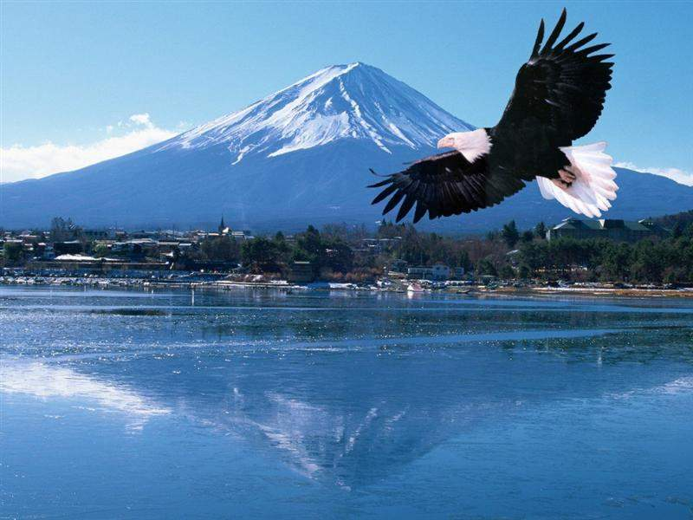
Birds
God's Creation…Day 5
"…and let birds fly above the earth in the open expanse of the heavens" (20b).

Slide 24
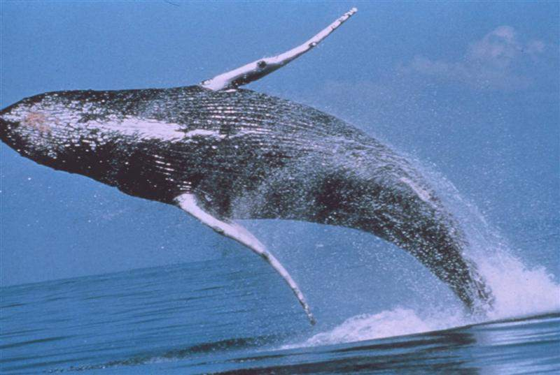
Whales
God's Creation…Day 5
God created the great sea monsters and every living creature that moves, with which the waters swarmed after their kind (21a)…

Slide 25
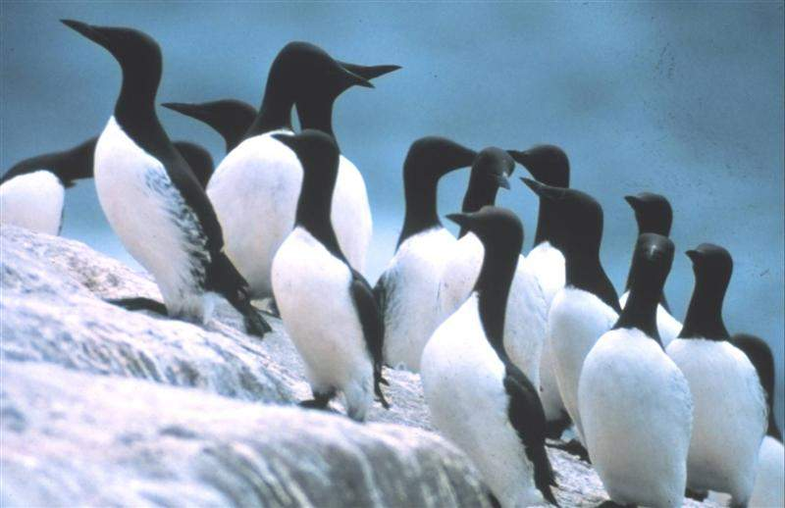
Penguins
God's Creation…Day 5
…and every winged bird after its kind; and God saw that it was good (21b).

Slide 26
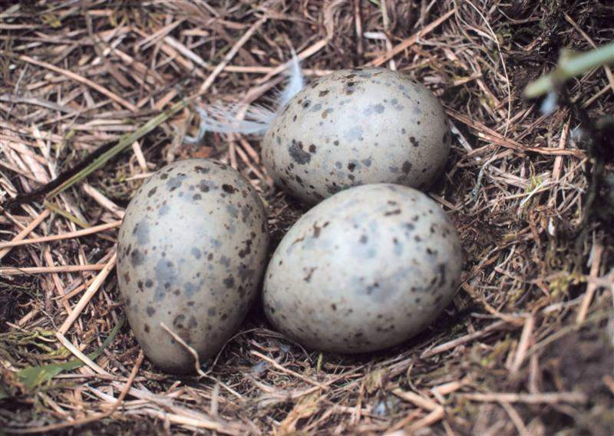
Multiply
God's Creation…Day 5
God blessed them saying, "Be fruitful and multiply, and fill the waters in the seas, and let the birds multiply on the earth" (22).

Slide 27

Fifth Day
God's Creation…Day 5
There was evening and there was morning, a fifth day (23).

Slide 28
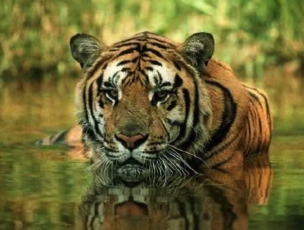
Animals
God's Creation…Day 6
448
"Then God said, 'Let the earth bring forth living creatures after their kind: cattle and creeping things and beasts of the earth after their kind'; and it was so. God made the beasts of the earth after their kind, and the cattle after their kind, and everything that creeps on the ground after its kind; and God saw that it was good" (Gen. 1:24-25).

Slide 29

Man
God's Creation…Day 6
448
"Then God said, 'Let Us make man in Our image, according to Our likeness; and let them rule over the fish of the sea and over the birds of the sky and over the cattle and over all the earth, and over every creeping thing that creeps on the earth'" (Gen. 1:26).

Slide 30

Woman
God's Creation…Day 6
"So God created man in his own image
in the image of God he created him
male and female he created them" (Gen. 1:27).

Slide 31

Mandate
448
and over the birds of the air
"And God blessed them, and God said to them, 'Be fruitful and multiply, and fill the earth and subdue it;
and have dominion over the fish of the sea
and over every living thing that
moves upon the earth'" (Gen. 1:28 NLT).

Slide 32

Food
Then God said, "Look, I have given you every green plant yielding seed that is on the surface of all the earth, and every tree which has fruit yielding seed; it shall be food for you" (29)

Slide 33
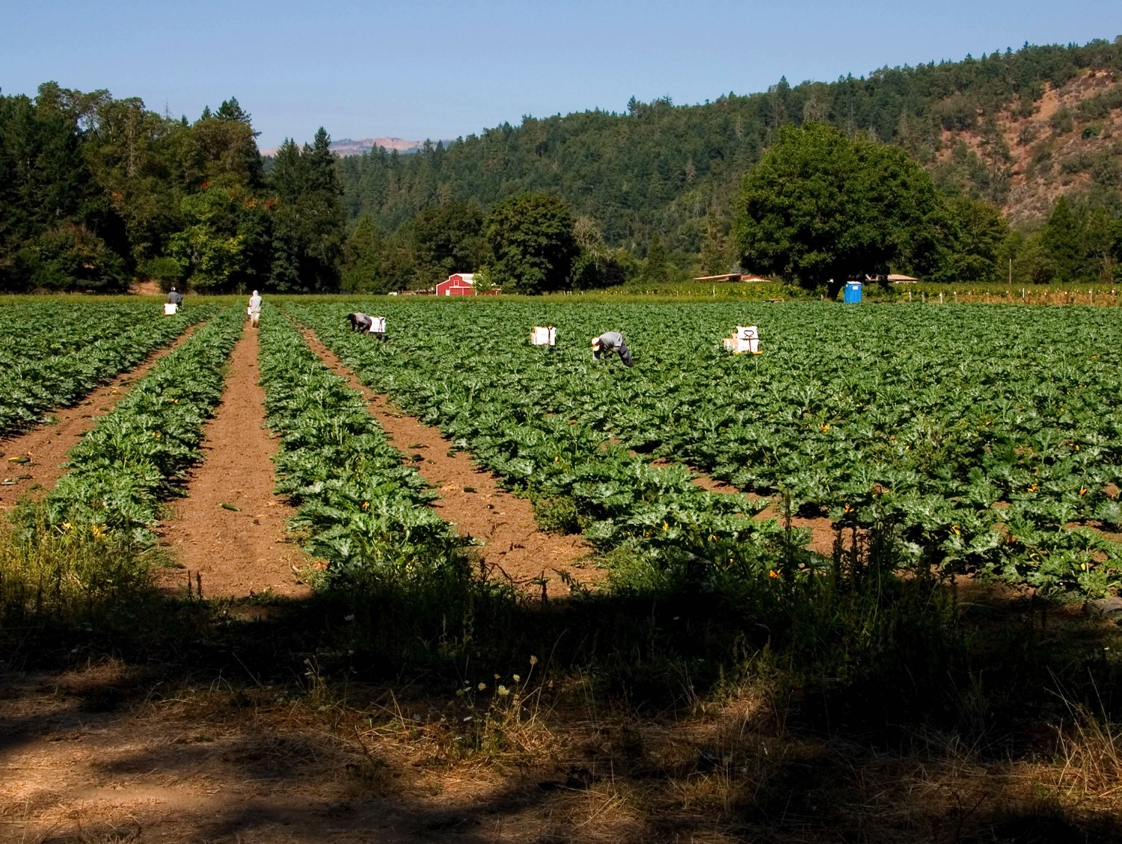
Food
"and to every beast of the earth and to every bird of the sky and to every thing that moves on the earth which has life, I have given every green plant for food"; and it was so (30).

Slide 34
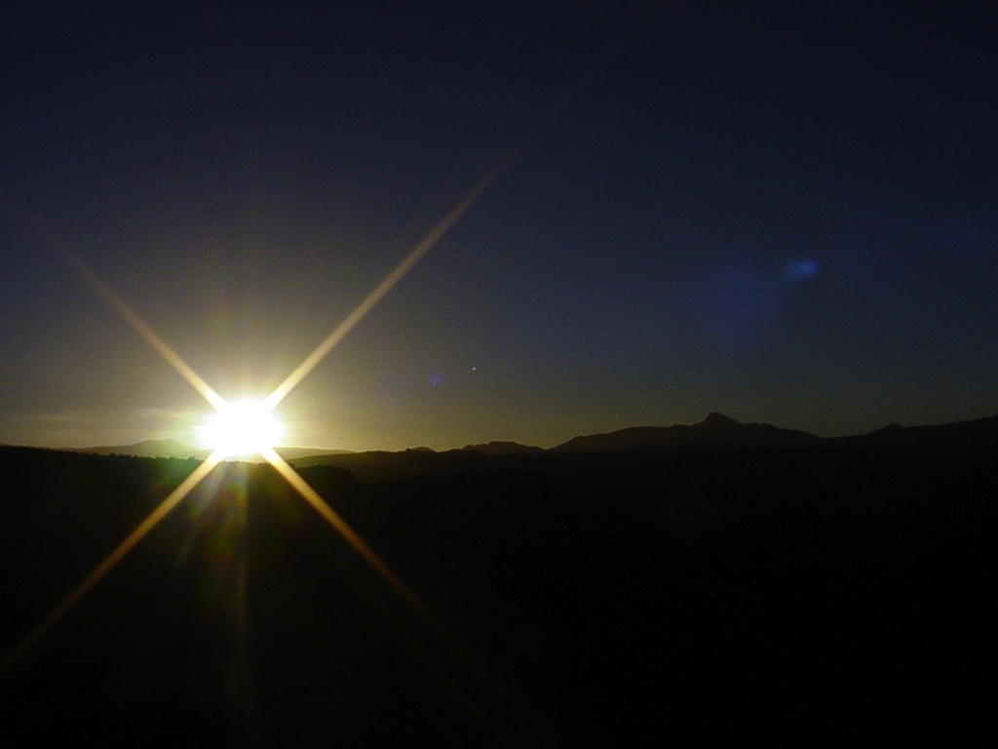
Sixth Day
God's Creation…Day 6
God saw all that He had made, and it was very good.
And there was evening and there was morning, the sixth day (31).

Slide 35
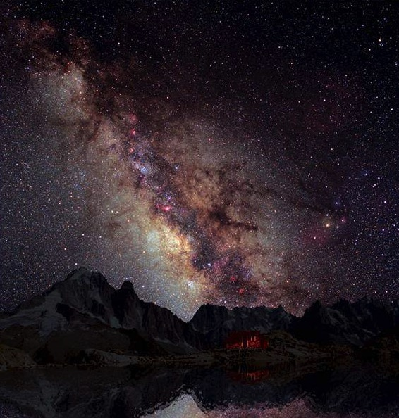
Summary
God's Creation…Day 7
Thus the heavens and the earth were completed,
and all their hosts (2:1)

Slide 36
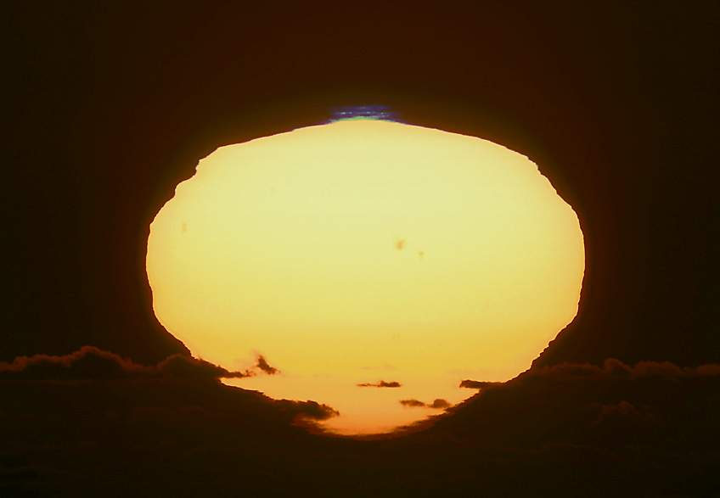
Day 7
God's Creation…Day 7
By the seventh day God completed His work which He had done, and He rested on the seventh day from all His work which He had done (2:2).

Slide 37
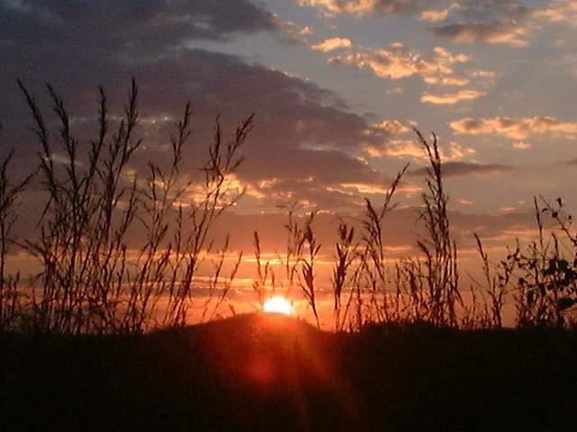
Sabbath
God's Creation…Day 7
Then God blessed the seventh day and sanctified it, because in it He rested from all His work which God had created and made (2:3).

Slide 38
Black
Notes:
Sumerians said that the high god raped the air goddess, resulting in the moon god.
Babylonians taught that king of the created gods (Marduk) murdered his mother (Tiamat) and cut her into two halves that became the land and sea (cf. Gen. 1:6-8).
So the world started from a son murdering his mother!

Slide 39

The Importance of Genesis

Slide 40
Every Person's Questions:
Where did we come from?
Why am I here?
Why is there evil in the world?
Is there hope?
©2003 TBBMI
7.5.03a.
18
Notes:
All people must answer the key issues of their origin, purpose, morality and destiny. This is why the Bible begins with creation (origin), man's rule (purpose), man's fall (morality), and God's rescue plan for sinful humanity (destiny). Genesis shows man as the pinnacle of creation, made to rule with God. However, he chose to rebel against God and ruined a perfect creation into the chaos we know today.

Slide 41

IN THE BEGINNING
Where did we come from?
God
created
the heavens and the earth
Genesis 1:1

Slide 42
Man
God's Creation…Day 6
Why am I here?
448
"Then God said, 'Let Us make man in Our image, according to Our likeness; and let them rule over the fish of the sea and over the birds of the sky and over the cattle and over all the earth, and over every creeping thing that creeps on the earth'" (Gen. 1:26).

Slide 43
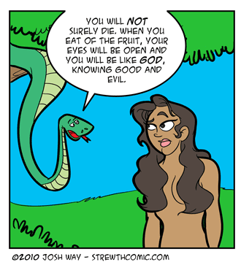
Convincing Dialogue
You will NOT surely die. When you eat of the fruit, your eyes will be open and you will be like GOD, knowing good and evil.
Why is there evil in the world?

Slide 44
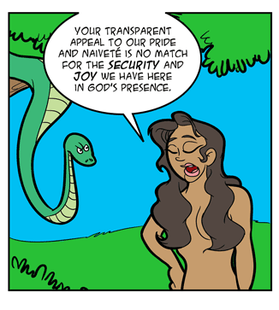
Convincing Dialogue
Your transparent appeal to our pride and naïveté is no match for the security and joy we have here in God's presence.

Slide 45

Convincing Dialogue
It's organic, rich in antioxidants, and now available in convenient GO-PACKS.
We'll take two.

Slide 46
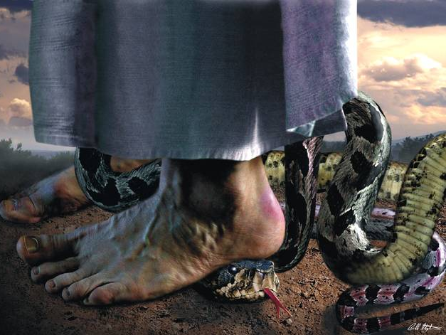
Genesis 3:15 (NLT)
"And I will cause hostility between you [Satan] and the woman [Eve], and between your offspring [satanic forces] and her offspring [Cain to Christ]. He [Christ] will strike your head [Calvary], and you will strike his heel [cripple mankind]."
Is there hope?
Notes:
46
This is what God said to Satan…
God promised a Savior to defeat Satan (3:14-15).
We have hated snakes since this day!
More seriously, God promised that one of Eve's descendants would strike the mortal blow to Satan. Jesus did this at the cross!

Slide 47
Black
Notes:
Sumerians said that the high god raped the air goddess, resulting in the moon god.
Babylonians taught that king of the created gods (Marduk) murdered his mother (Tiamat) and cut her into two halves that became the land and sea (cf. Gen. 1:6-8).
So the world started from a son murdering his mother!

Slide 48

How to Read Genesis 1 on Creation

Slide 49

Is Genesis 1 clear?
Gen. 1:1

Slide 50
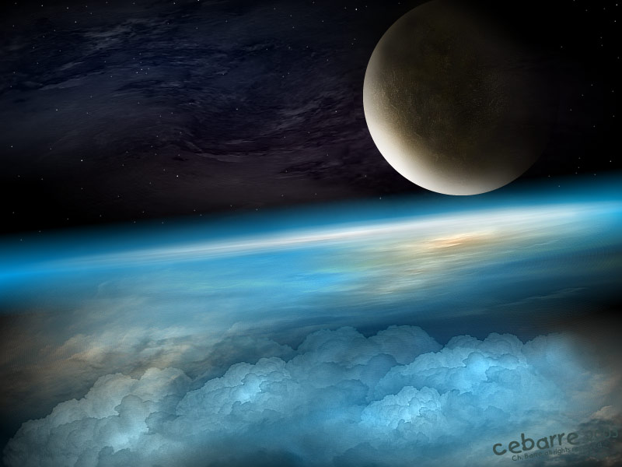
Our God is King who created everything in contrast to man-made ideas
(Gen. 1).

Slide 51

Days of Creation
33
Void
Formless
Forming
Filling
Day 4: Sun, moon & stars arranged
Day 1: Light
Day 2: Water & air separated
Day 5: Fish & fowl
Day 3: Land & sea separated
Day 6: Animals & man
Genesis 1:3-31

Slide 52


GOD: I just created a
24-hour period of alternating lightness and darkness on earth…
ANGEL:
What are you going to do now?
GOD:
Call it
a day.

Slide 53

Why 24 Hours?
70b
Instantaneous creation
"By the word of the LORD were the heavens made, their starry host by the breath of his mouth" (Ps. 33:6)
"There is certainly no thought here of delay, or a trial-and-error process, or a gradual, step-by-step fulfillment"
– John Whitcomb, The Early Earth, 24

Slide 54
Why 24 Hours?
70b
Instantaneous creation (Ps. 33:6)
"evening and morning"

Slide 55

Dan. 8:26 alone (besides Gen 1) has "evening & morning"
––with a literal view
"The vision of the evenings and mornings which has been told is true; But keep the vision secret, for it pertains to many days in the future" (NASB).

Slide 56
Why 24 Hours?
Instantaneous creation (Ps. 33:6)
"evening and morning"
Numerical adjective ("second…")
In Hebrew, when "day" (yom) is preceded by a numericial adjective, "day" is always literal!

Slide 57

Numbers 7:12
"Now the one who presented his offering on the first day was Nahshon…"

Slide 58
First Day
God's Creation…Day 1
God called the light day, and the darkness He called night. And there was evening and there was morning, one day (Gen. 1:5).

Slide 59
Why 24 Hours?
Instantaneous creation (Ps. 33:6)
"evening and morning"
Numerical adjective ("second…")
Pattern for work & rest

Slide 60

We get our 7-day week from Genesis 1

Slide 61


When to Start the Day…
6
PM
12
AM
6
AM
12
PM
6
PM
12
AM
6
AM
12
PM
6
PM
Roman
Day 1
Day 2
Jewish
Day 1
Day 2
There was evening…
…and morning…
There was evening…
…and morning…
…one day.
…the
second day.
Notes:
Our "day" today beginning at midnight came from the Romans hundreds of years after the Jewish reckoning from evening to evening that is used in Genesis 1.

Slide 62
Why 24 Hours?
Instantaneous creation (Ps. 33:6)
"evening and morning"
Numerical adjective ("second…")
Pattern for work & rest
Sun & moon not until day 4
Notes:
Could God’s handiwork be seen on days 1-3? Not if they took thousands or millions of years!

Slide 63

Romans 1:20
161
Since the start of creation…
people have seen God
= literal 24-hour days
"For since the creation of the world God's invisible qualities—his eternal power and divine nature—have been clearly seen, being understood from what has been made, so that men are without excuse" (NIV).

Slide 64

When did death come into the world?

Slide 65

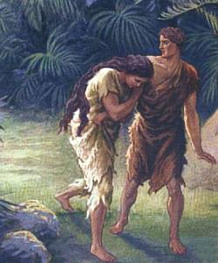
Did death exist before sin?
What do you think?
VERY GOOD
What does it mean that creation was "very good" if death existed then?
Notes:
So did death exist before sin? What do you think? God said that his creation up to this time was "very good." What does it mean that creation was "very good" if death existed then?

Slide 66
Creation Theories
24-Hour Day
1 day = literal 24 hours
Day-Age
1 day = indefinite era
Literary
7 days = symbolic
Prior Creation
Creation | Gap | Re-Creation
1:1 1:2-2:3
Two-Phase
Creation | Gap | Creation
1:1-2:3 2:4-25
Genesis 1

Slide 67
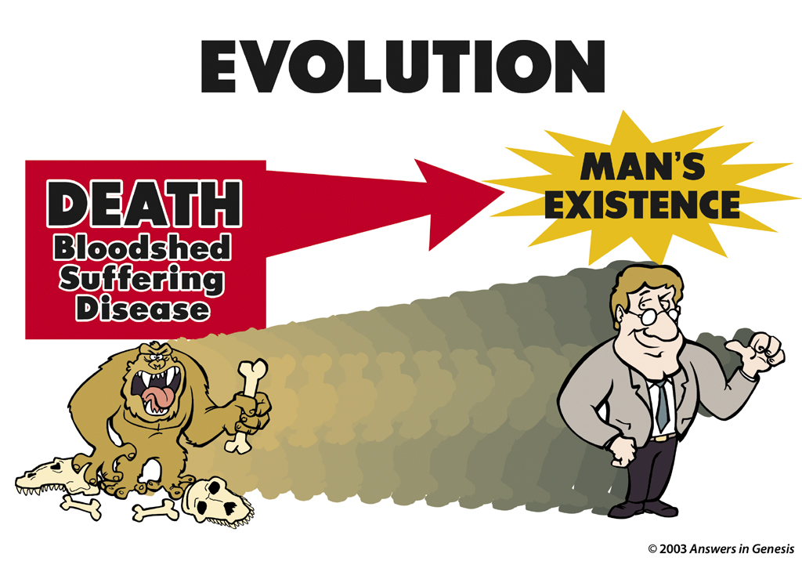
Evolution: Death-Man 00413
EVOLUTION
MAN'S EXISTENCE
DEATH
Bloodshed
Suffering
Disease

Slide 68
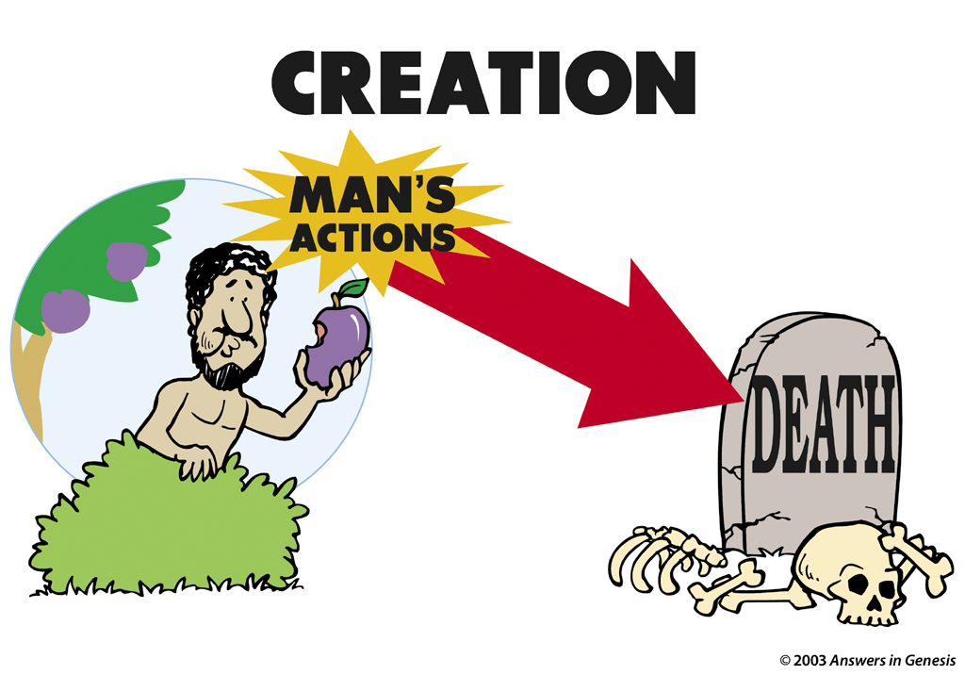
Creation: Actions-Death 00412
CREATION
MAN'S ACTIONS

Slide 69
Black
Notes:
Sumerians said that the high god raped the air goddess, resulting in the moon god.
Babylonians taught that king of the created gods (Marduk) murdered his mother (Tiamat) and cut her into two halves that became the land and sea (cf. Gen. 1:6-8).
So the world started from a son murdering his mother!

Slide 70

Genealogies
& OT Chronology
Genesis 5 & 11

Slide 71
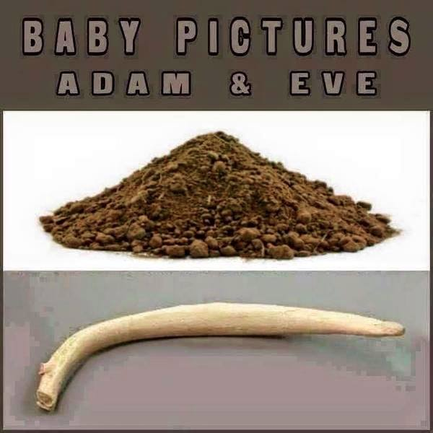

Baby Pictures of Adam & Eve
Notes:
Do you recognize these? Do you know what these are? They are baby pictures!
One woman noted, "Sure God created man before woman, but then again you always make a rough draft before creating the final masterpiece."
(http://cher-homespun.blogspot.sg/2011/06/firewater-friday-sure-god-created-man.html accessed 15 August 2015)

Slide 72
Genesis 5 Genealogy
38
Adam
Seth
Enosh
Kenan
Mahalalel
Jared
Enoch
Methuselah
Lamech
Noah

Slide 73

Can We Find the Date of Creation from Genesis 5 & 11?
Some Say "No"
Other genealogies in the Bible have gaps (e.g., Matt. 1:1-17)
Therefore there must be gaps in Genesis
A "no gap" view puts the Flood at 2487 BC but Egypt's history goes back before 3300 BC
Others Say "Yes"
The other genealogies do not give the father's ages when their sons were born
God wants us to "mark seasons and days and years" (Gen. 1:14)
Why else would God give us the ages of these men?

Slide 74
Genesis Genealogy Mysteries
Adam
Genesis 5
Noah
Shem
Genesis 11
Terah
Can these genealogies help determine the dates of events in history?

Slide 75

Why Don't Genesis 5 & 11 Have Gaps?
38
Adam
State lengths of time
Seth
Enosh
Kenan
Mahalalel
Jared
Enoch
Methuselah
Lamech
Noah

Slide 76
Age at Son's Birth
38
Adam-130
Seth-105
Enosh-90
Kenan-70
Mahalalel-65
Jared-162
Enoch-65
Methuselah-187
Lamech-122
Noah-500

Slide 77
Why Don't Genesis 5 & 11 Have Gaps?
38
Adam
State lengths of time
Shorter lengths
Seth
Enosh
Kenan
Mahalalel
Jared
Enoch
Methuselah
Lamech
Noah

Slide 78
Genesis 5 Shorter Than Luke 3
38
Adam
Adam
2006
yrs
Noah
4138
yrs
Christ

Slide 79
Why Don't Genesis 5 & 11 Have Gaps?
38
Adam
State lengths of time
Shorter lengths
Most natural
Show father-son
Jude 14
Similar ANE chronologies
Seth
Enosh
7
Kenan
Mahalalel
Jared
Enoch
"Enoch, in the seventh generation from Adam, prophesied saying. . . "
(Jude 14a, NASB)
Methuselah
Lamech
Noah

Slide 80
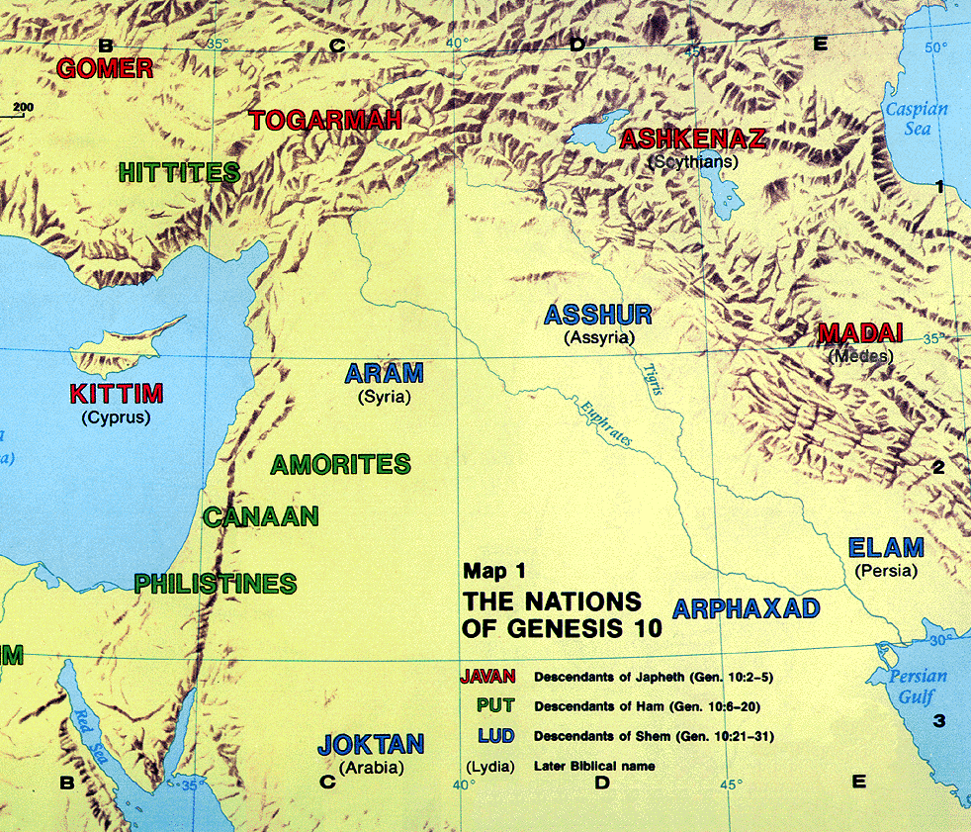
The Table of Nations
OTB 60
Pt. 6
NOAH
Japheth
HAM
SHEM
Caucasians
Canaanites
Semites
Europeans &
East Indians
Africans &
Asians
Jews &
Arabs
Genesis 10

Slide 81

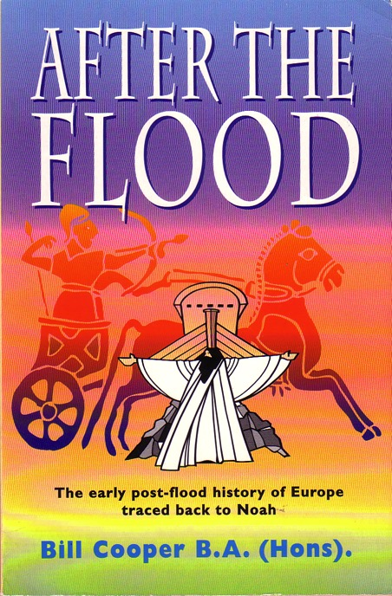
Is the Table of Nations Accurate (Gen. 10-11)?
OTB 60
Pt. 6
MS
"Having constructed the Table of Nations into a simple genealogy, I wanted to see how many of its names were attested in the records of other nations in the Middle East… [I saw that] the Table of Nations had listed all the families and tribes of mankind in their correct groupings, whether those groupings were ethnological, linguistic or geographical. All the names, without exception, were accurate, and in more than twenty-five years of searching and analyzing, I uncovered not one mistake or false statement of fact in the Table of Nations."
Bill Cooper, After the Flood (Chichester: New Wine, 1995), 38-39
SG
ER
DS
PG
RS
Handbook pg. 15-16
25
1

Slide 82
Straight Chronology Support
The Bible is filled with much chronological information though scattered in many places
When this chronological information is fully systematized, a straight chronology may be proven

Slide 83
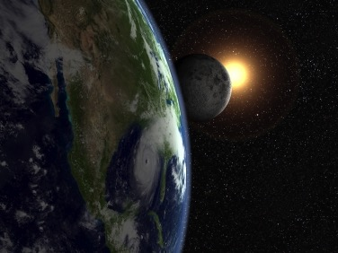
How can you tell the age of the earth?
Just ask the only Eyewitness!

Slide 84
"Just do the math."
"God, how old is the earth?"

Slide 85
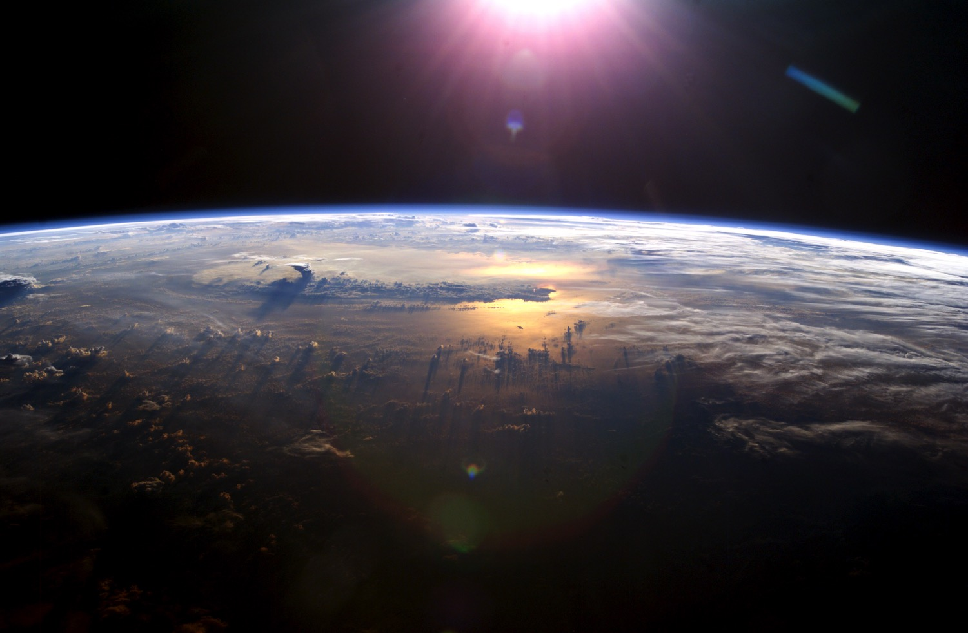
Chronology of the Patriarchs (Gen. 5, 11)
38-44
Event
Reference
AH
BC
World created
"God finished"
-6 days
4143
Adam created
"God created man"
0
4143
Seth born
"Adam was 130…"
130
4013
Enosh born
"Seth was 105…"
235
3908
Jacob & family go to Egypt
"Jacob age 130 at 400 years before Exodus in 1445 BC"
2298
1845

Slide 86
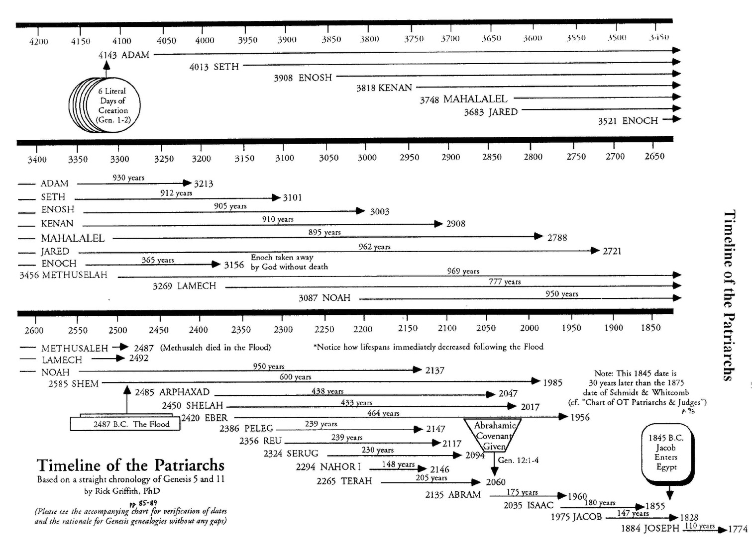
Methuselah's Death
44
Adam & Methuselah contemporaries
Adam probably told Methuselah the creation account, who told Shem, who told Abraham—only 3 retellings apart!
2487
A straight chronology works out exactly to show that Methuselah died in the year of the Great Flood!
2487
Methuselah & Shem contemporaries
Shem & Abraham contemporaries

Slide 87
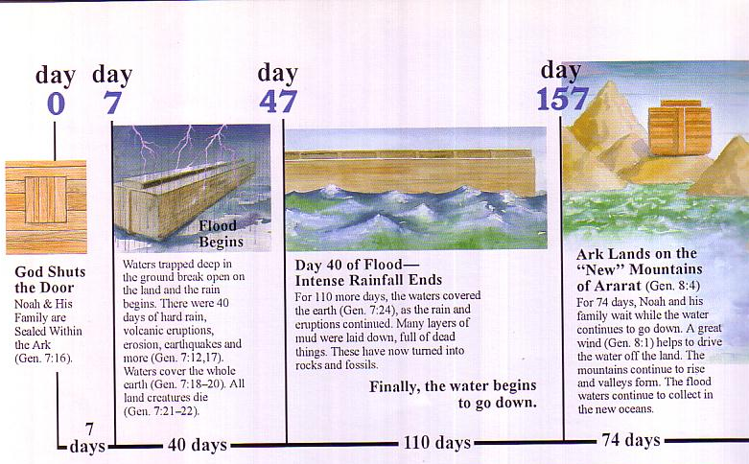
Flood Chronology
Day
0
Day
7
Day
47
Day
157
Flood Begins
Waters trapped deep in the ground break open on the land in 40 days of hard rain with volcanic eruptions, erosion, earthquakes, and more （Gen 7：12，17）. Waters cover the whole earth (Gen 7:18-20). All land creatures die （Gen 7:21-22）.
Day 47 of Flood—Intense Rainfall Ends
For 110 more days, the waters cover the earth （Gen 7：24）, as the rain and eruptions continue. Many layers of mud laid down, full of dead things. They have now turned into rocks and fossils.
Finally, the water begins to go down.
Ark Lands on New Ararat Mountains （Gen 8：4）
For 74 days, Noah and his family wait while the water continues to go down. A great wind（Gen 8：1） helps to drive the water off the land. The mountains continue to rise and valleys form. The flood waters continue to collect in the new oceans.
God Shuts the Door
Noah and his family sealed within the ark（Gen 7：16）.
7
Days
40
Days
110
Days
74
Days

Slide 88
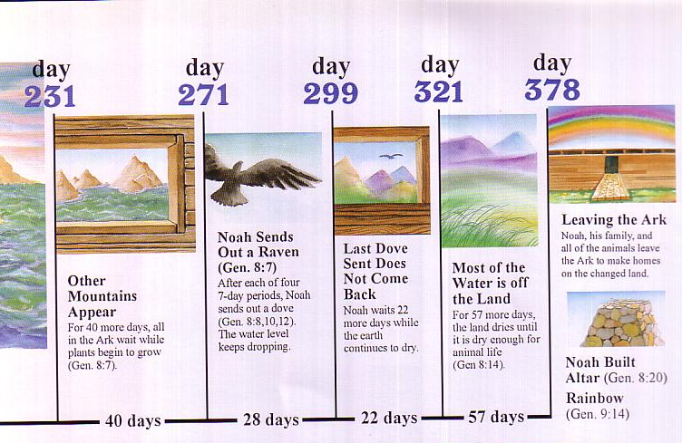
Flood Chronology
Day
231
Day
271
Day
299
Day
321
Day
378
Leaving the Ark
Noah, his family and the animals leave the ark to make homes on the changed land.
Noah Sends Out a Raven （Gen 8：7）
After each of four
7-day periods, Noah sends out a dove (Gen 8：8，10，12). The water level keeps dropping.
Most of the Water is Off the Land（Gen 8:14）.
For 57 more days, the land dries until it is dry enough for animal life
(Gen 8:14).
Last Dove Sent Does Not Come Back
Noah waits 22 more days while the earth continues to dry.
Other Mountains Appear
For 40 more days, all in the ark wait while plants begin to grow （Gen 8:7）.
Noah Builds Altar （Gen 8：20）
Rainbow
（Gen 9：14）
40
Days
28
Days
22
Days
57
Days

Slide 89



Patriarch's long lives
90
Ages of people when they died
Adam
930 Years
Methuselah
969 Years
Noah
950 Years
Shem
600 Years
The Flood explains why life spans shortened
Abraham
175 Years
Moses
120 Years
David
70 Years
Notes:
From John Morris, Noah's Ark and the Ararat Adventure, p. 10.

Slide 90

How can you tell the age of the earth?
Trust the Book written by the Eyewitness

Slide 91
Black
Notes:
Sumerians said that the high god raped the air goddess, resulting in the moon god.
Babylonians taught that king of the created gods (Marduk) murdered his mother (Tiamat) and cut her into two halves that became the land and sea (cf. Gen. 1:6-8).
So the world started from a son murdering his mother!

Slide 92

Why Theologians Disagree

Slide 93
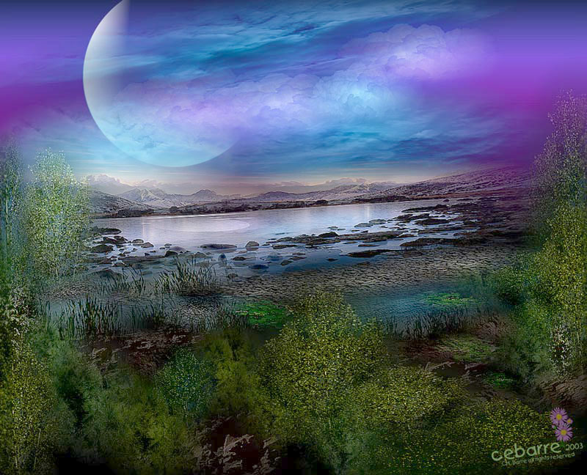
Creationism and God's Kingship are continually attacked today.

Slide 94
Days of Creation
64
Void
Formless
Forming
Filling
Day 4: Sun, moon & stars arranged
Day 1: Light
Day 2: Water & air separated
Day 5: Fish & fowl
Day 3: Land & sea separated
Day 6: Animals & man
Genesis 1:3-31

Slide 95
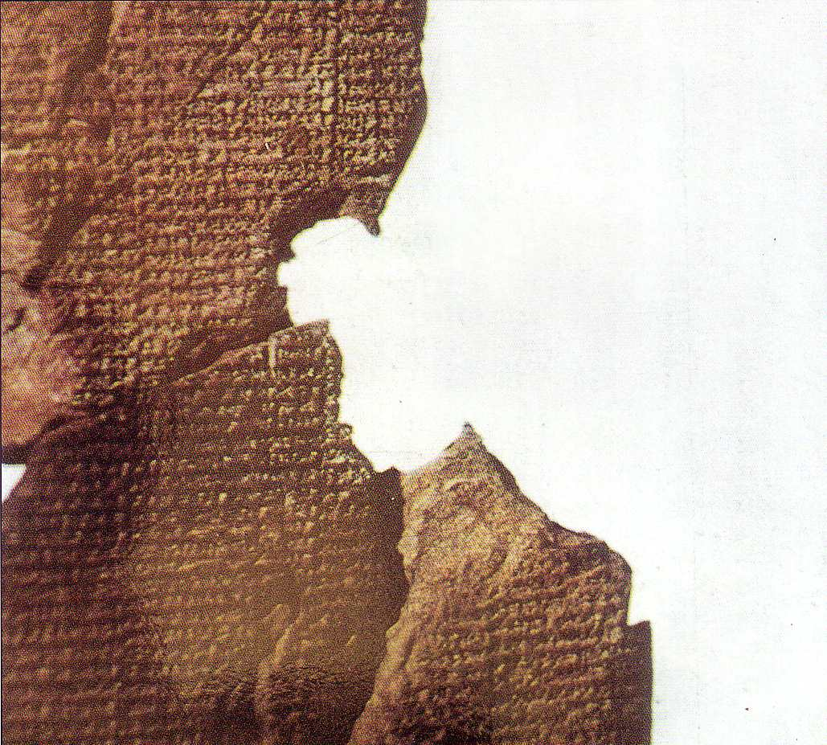
Atrahasis Epic
"Let the birth-goddess create offspring, and let man bear the toil of the gods… create humanity that he may bear the yoke… let Nintu mix clay, that god and man may be thoroughly mixed in the clay, let there be a spirit from the god's flesh"
(Arnold/Beyer, 24)
Akkadian 1650 BC
Creation & flood stories
Man created to help overworked gods
Man made from clay

Slide 96
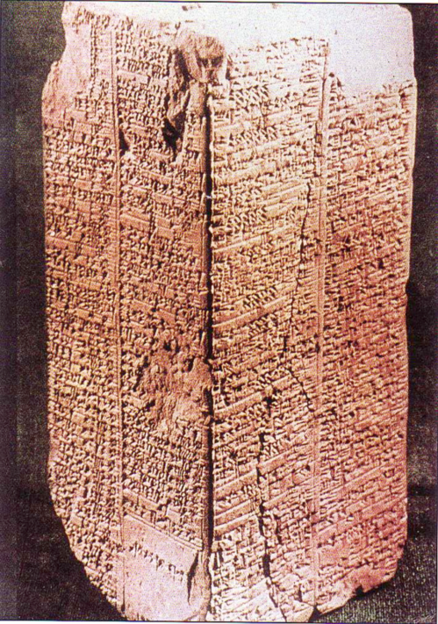
Sumerian King List
Inscribed about 1800 BC (about 600 years after the Flood)
Ten of these kings before the Flood are said to have lived between 21,000 to 43,200 years each
(cf. Gen. 5)
Arnold & Beyer, Readings from the ANE, 150
Notes:
See Clifford Wilson, The Stones Sill Shout, 25 and Arnold/Beyer, Readings from the ANE, 150.

Slide 97
Sumerian King List
OTB, 64a
"When kingship came down from heaven. . .
Alulim became king and reigned for 28,800 years…
Eight kings reigned for 241,000 years. Then the flood waters streamed over the earth."
King & Years of Reign
Alulim 28,800
Alalgar 36,000
Enmenluanna 43,200
Enmengalanna 28,800
Dumuzi 36,000
Ensipazianna 28,800
Enmeduranna 21,000
Urbatutu 18,600
Total 241,000
Arnold & Beyer, Readings from the ANE, 150
Notes:
See Clifford Wilson, "The Stones Sill Shout p. 25 and Arnold/Beyer, "Readings from the ANE," 150

Slide 98
Sumerian King List
None of us believe in kings who reigned 28,800 years, but it does show a belief in long ages and a worldwide flood.
Arnold & Beyer, Readings from the ANE, 150
Notes:
See Clifford Wilson, The Stones Sill Shout, 25 and Arnold/Beyer, Readings from the ANE, 150.

Slide 99

Evangelicals Differ
34
70d
Reasons to Believe
Hugh Ross
Walt Brown
Old Earth
Progressive Creation
Mid-East Flood
Rain waters
reasons.org
godandscience.org
creationscience.com
Institute for Creation Research
Henry/John Morris, Duane Gish
Joseph Dillow, Ken Ham
Young Earth
24-hour Creation Days
Universal Flood
Vapor canopy
answersingenesis.org
genesispark.org
icr.org critiques Ross at:
icr.org/pubs/imp/imp-217.htm

Slide 100
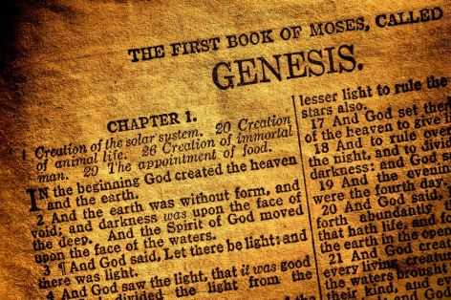
Genesis: Literal or Literary?
Literal?
Theological History
Literary?

Slide 101
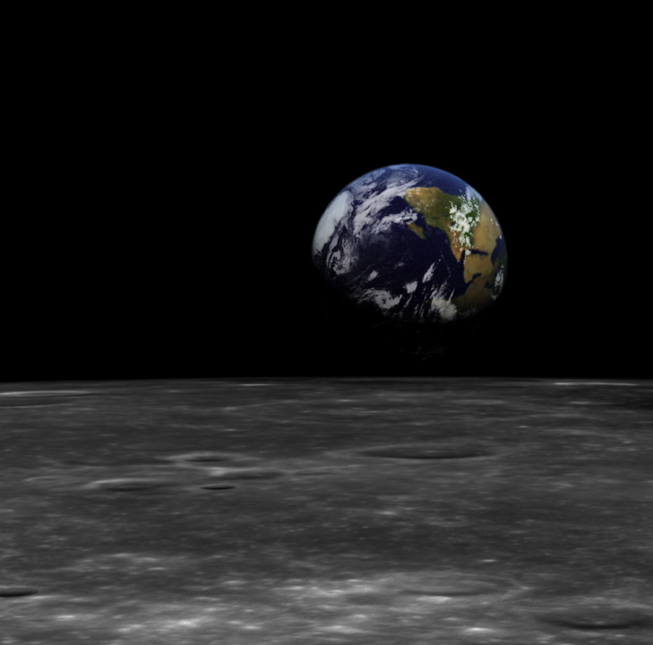
God as King in Genesis 1
Uncreated God (1:1)
Creation by Word alone (1:4)
Creation with ease
Sun and moon [gods] created (1:16)
Shared rule with man (1:26)

Slide 102
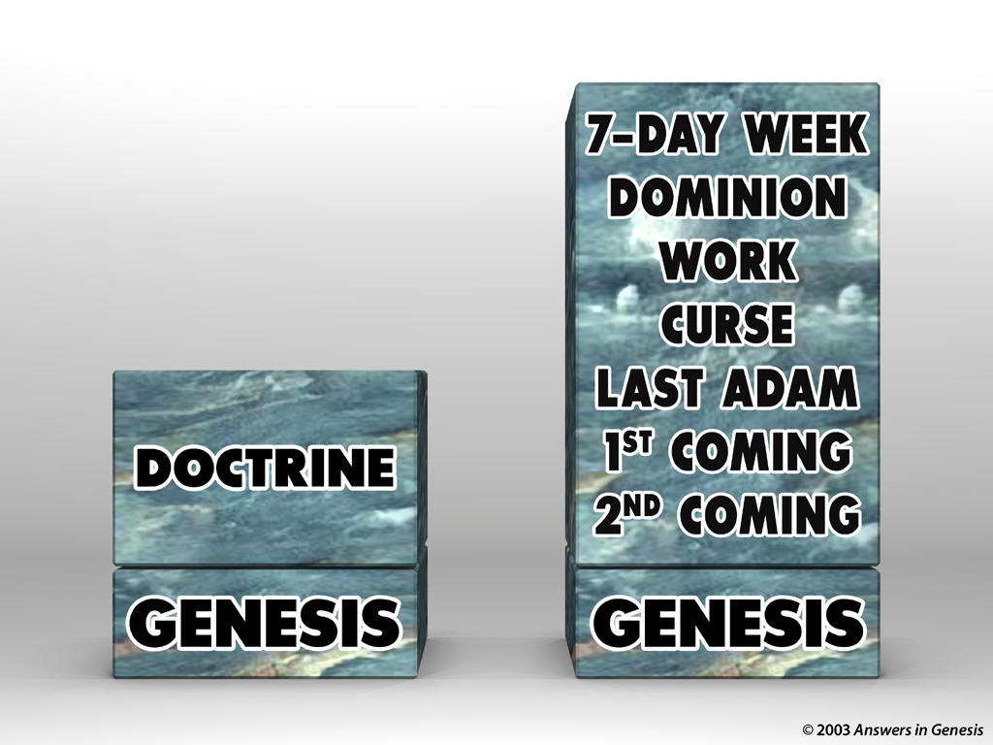

Blocks-Genesis Doctrine & Doctrines 00405
2ND COMING
1ST COMING
LAST ADAM
CURSE
DOMINION
DOCTRINE
WORK
7-DAY WEEK
GENESIS
GENESIS

Slide 103
Q335-Sagan 00434
WHAT is your ultimate authority?
The Bible or science?
WHO is your ultimate authority?
God
or people?

Slide 104

Nailing Genesis 1-11 to church
GENESIS
1-11
MAN'S OPINIONS
MILLIONS OF YEARS
Notes:
104

Slide 105

Blocks-God's Word & Man's Opinion 00403
MEANING
OF LIFE
ABORTION
STANDARDS
PORNOGRAPHY
MARRIAGE
HOMOSEXUALITY
LAWS
LAWLESSNESS
CREATION
GOD'S
WORD
EVOLUTION
MAN'S
OPINION

Slide 106

Reinterpretations 00363

Slide 107

Science itself constantly changes

Slide 108


Rewriting Earth’s Creation Story
Science itself constantly changes
“We as a scientific community created an origin myth that has no more intellectual value than Genesis.”
Notes:
Rewriting Earth's Creation Story
"We as a scientific community created an origin myth that has no more intellectual value than Genesis."
The iconic image of the Earth taken aboard Apollo 8 NASA
Rebecca Boyle Sep 27, 2016
Accessed 30 Sep 2016
http://www.theatlantic.com/science/archive/2016/09/hadean/501668/
"Humanity's trips to the moon revolutionized our view of this planet. As seen from another celestial body, Earth seemed more fragile and more precious; the iconic Apollo 8 image of Earth rising above the lunar surface helped launch the modern environmental movement. The moon landings made people want to take charge of Earth's future. They also changed our view of its past.
Earth is constantly remaking itself, and over the eons it has systematically erased its origin story, subsuming and cannibalizing its earliest rocks. Much of what we think we know about the earliest days of Earth therefore comes from the geologically inactive moon, which scientists use like a time capsule.
Ever since Apollo astronauts toted chunks of the moon back home, the story has sounded something like this: After coalescing from grains of dust that swirled around the newly ignited sun, the still-cooling Earth would have been covered in seas of magma, punctured by inky volcanoes spewing sulfur and liquid rock. The young planet was showered in asteroids and larger structures called planetisimals, one of which sheared off a portion of Earth and formed the moon. Just as things were finally settling down, about a half-billion years after the solar system formed, the Earth and moon were again bombarded by asteroids whose onslaught might have liquefied the young planet—and sterilized it.
Geologists named this epoch the Hadean, after the Greek version of the underworld. Only after the so-called Late Heavy Bombardment quieted some 3.9 billion years ago did Earth finally start to morph into the Edenic, cloud-covered, watery world we know.

Slide 109

Science itself constantly changes
“Although we’re very quick to criticize those that operate on faith, that’s exactly what we did.”
Notes:
Rewriting Earth's Creation Story
"We as a scientific community created an origin myth that has no more intellectual value than Genesis."
The iconic image of the Earth taken aboard Apollo 8 NASA
Rebecca Boyle Sep 27, 2016
Accessed 30 Sep 2016
http://www.theatlantic.com/science/archive/2016/09/hadean/501668/
"…
"Although we're very quick to criticize those that operate on faith, that's exactly what we did."But as it turns out, the Hadean may not have been so hellish. New analysis of Earth and moon rocks suggest that instead of a roiling ball of lava, baby Earth was a world with continents, oceans of water, and maybe even an atmosphere. It might not have been bombarded by asteroids at all, or at least not in the large quantities scientists originally thought. The Hadean might have been downright hospitable, raising questions about how long ago life could have arisen on this planet.
"Although, if you go back to the original Greek Hell, Hades, you had to cross a river. It's a cool, wet place. So maybe the joke is on us," says Mark Harrison, a geologist at the University of California at Los Angeles.
Samples collected by Apollo astronauts helped give rise to the Late Heavy Bombardment idea because of chemical traces embedded within them. Potassium and argon isotopes in the moon rocks suggested they suffered catastrophic heating around 3.9 billion years ago. Along with the moon's many craters, this was evidence of a real battering. But this contradicts evidence in meteorites that have made their way from the moon back to Earth. When geologists analyze those rocks, there is no 3.9-billion-year signal. There is no signal in meteorites from the large asteroid Vesta, either, though presumably it would have also been hammered by the same rocks flung at Earth and the moon. The Apollo rocks might be fooling us."

Slide 110

We must defend against attacks on God as Creator and King.

Slide 111

Balloons problem—evol vs creat
Gay
Marriage
THE
PROBLEM
Abortion
PSALM 11:3
Moral
Relativism
Euthanasia
CHRISTIANITY
HUMANISM
EVOLUTION
CREATION
Notes:
111
The humanistic philosophies all are undermining the very foundation of what Christians believe by focusing their attacks at creation.
Meanwhile, Christians accept their evolutionary theory and then focus our attacks at the results of humanism instead of attacking the foundation in evolution.
Some Christians shoot their own foundation and others are asleep or shooting other Christians.

Slide 112

Balloons problem—man's vs God's word
THE
SOLUTION
ISAIAH 58:12
Gay
Marriage
Moral
Relativism
CHRISTIANITY
HUMANISM
MAN'S WORD
GOD'S WORD
Notes:
112

Slide 113

Key Thoughts
I. Our God is King who created everything in contrast to man-made ideas (Gen. 1).
II. Creationism and God's Kingship are continually attacked today.
III. We must defend against attacks on God as Creator and King.

Slide 114

Coming to Grips with Genesis 04702
Coming to Grips with Genesis
  edited by Dr. Terry Mortenson
  and Dr. Thane Ury
14 scholars give a careful Biblical & historical defense of
young-earth creationism
© 2008 Answers in Genesis-USA
Notes:
114

Slide 115

AiG Web Address 00439

Slide 116


Creation link at BibleStudyDownloads.org
Get this presentation for free!
Notes:
OT Survey (os)

Slide 117

BibleStudyDownloads.org

Slide 118

BibleStudyDownloads.org

Slide 119

BibleStudyDownloads.org

Slide 120

BibleStudyDownloads.org

Slide 121

Main Idea
How do we fight the pagan philosophies of our day?
Defend God
as Creator and King!

Slide 123
Creation link at BibleStudyDownloads.org
Get this presentation for free!
Notes:
OT Survey (os)

